Slide 1

Presentation Slides For Mobile App Based on BLOOD DONATION
Give Blood For Others

Slide 2


Agenda
We believe helping is the best process to live together.
Confirm their availability
Save life
Collecting Donor
Save Money
For increasing
Blood Service

Slide 3

App Features
Our app Features are below with details.
Blood Group
Reminder
Organize with all blood group
Reminder for blood donating time and can track activity.
Security
Health tips
For personal information User can trust us 100%. Because we always careful about user security
Some important daily health tips.
Notification
Donor Searching
For blood request user will get notifications on up-to-date.
User can search donor according to blood group.

Slide 4
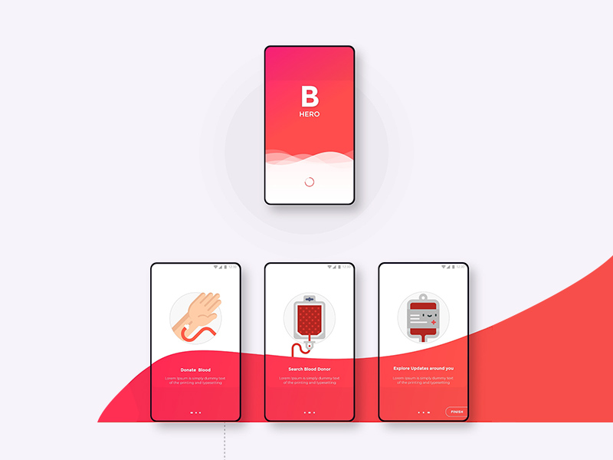


Why this project
Benefits by this app
Social work is a good thinking. For commercial we can use it for business without lose main behavior of social work. We design this app for social work as a commercial view.
Marketing
Any company can ad by this app as a social work.
Helping hand
One people can help more people by this app.
Money saving
It’s a huge idea that can save money for any company.

Slide 5
SWOT Analysis
SWOT analysis of our team.
Strength
Weakness
Opportunity
Threat
We are so confident about this project that’s why we can build it and we will.
We are not thinking about it because if we think about this it will come to us.
By this project we can make our confidence and experience more effective.
Laziness and careless is the big threat. So we all mind it.
O
W
S
T

Slide 6





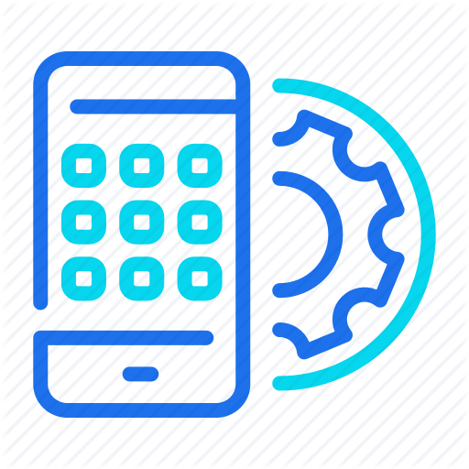
Step by Step
Our Project process
Requirement gathering.
Submit
Design
Testing
Development

Slide 7

Our Group
Fajlul Karim chowdhury
171442505
Cse (EVE)
Jubayer Haque
Sharmin Akter
171442591
Cse (EVE)
171442575
Cse (EVE)

Slide 8
READY TO BUILD THIS PROJECT
Give Blood For Others

